Slide 1

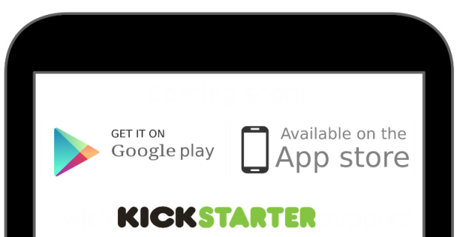

Slide 2

PRIVACY - Personalize your profile without sacrificing your privacy
FREEDOM - We want you to be whatever or whomever you want
PROPERTY - You own your personal information, data and content

Slide 3

How it works

Slide 4
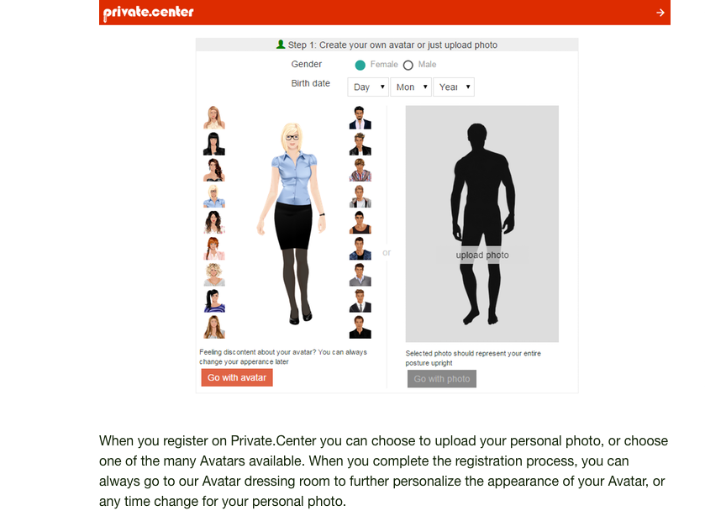

Slide 5
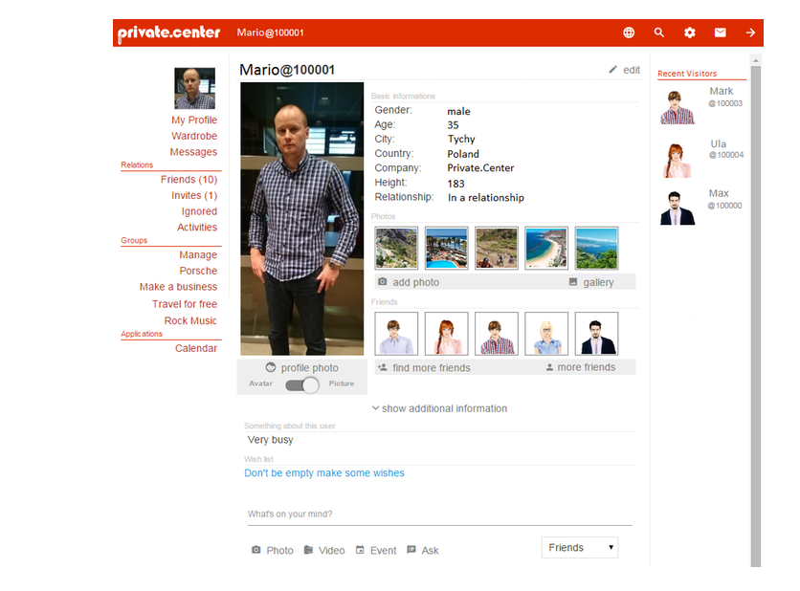

Slide 6
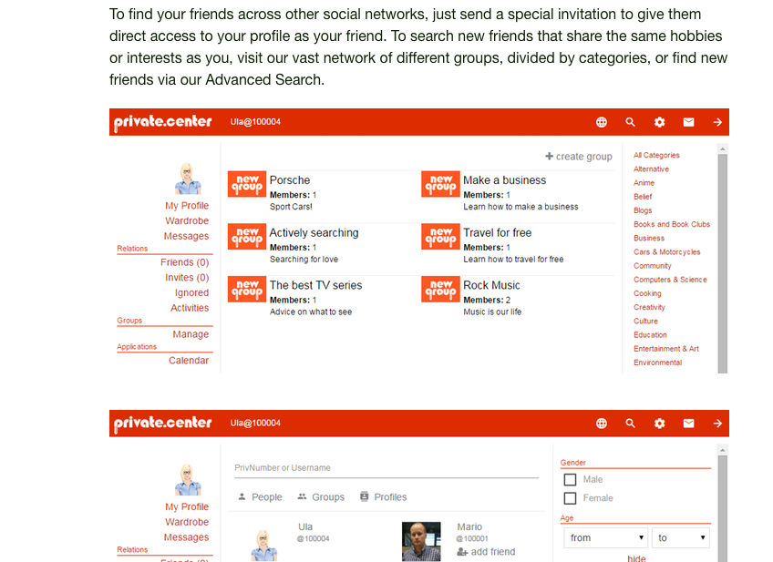

Slide 7
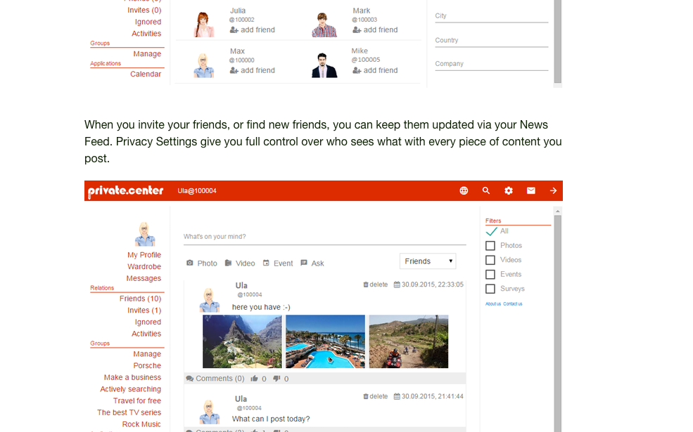

Slide 8
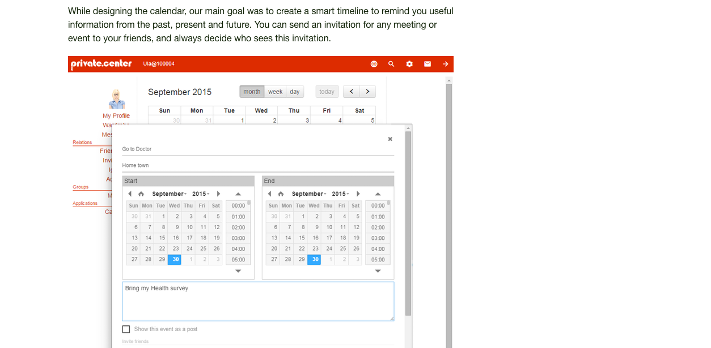

Slide 9
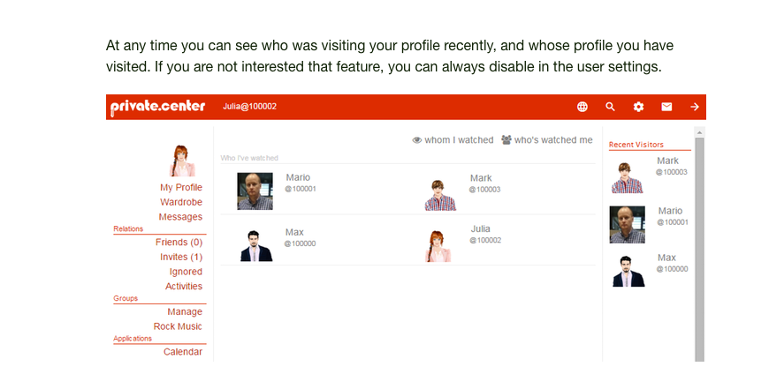

Slide 10
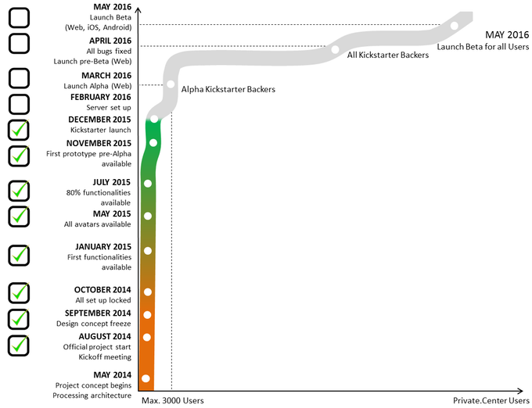
Project timeline

Slide 11
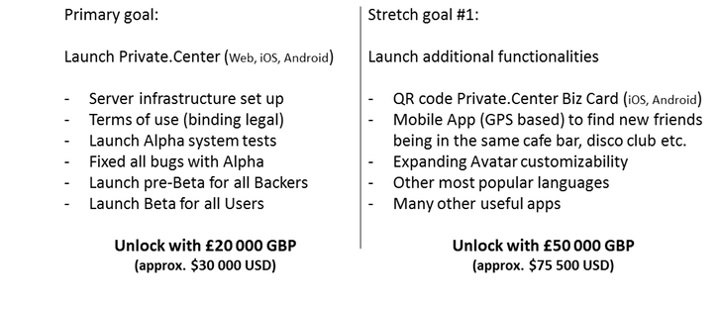
Goals

Slide 12
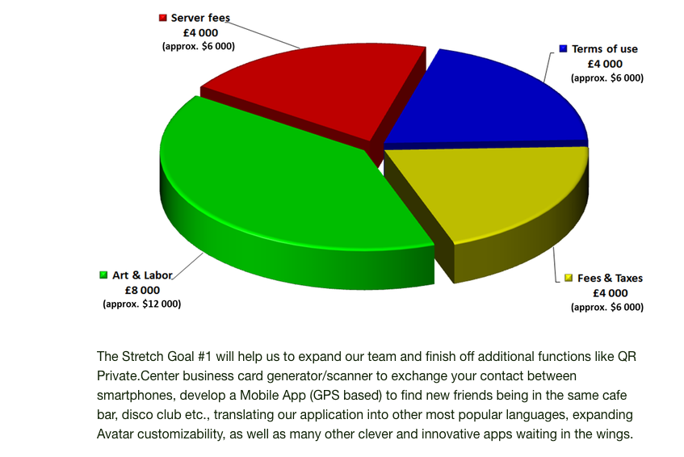

Slide 13
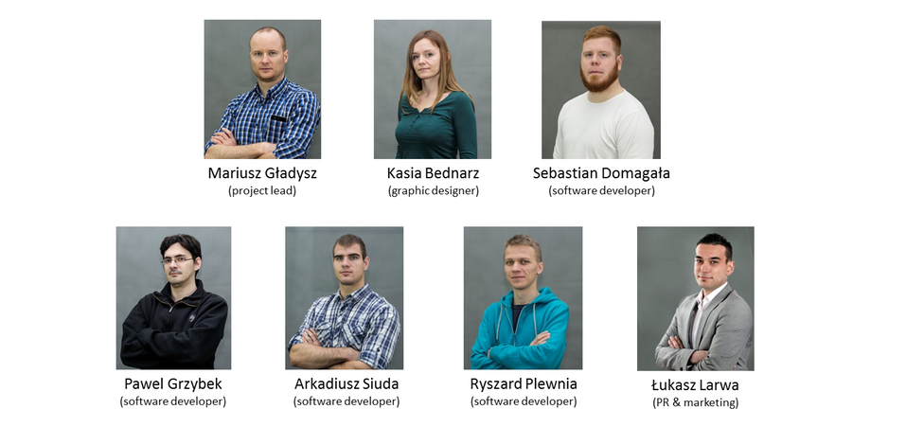
Our team

Slide 14




Interested?

