Slide 1
The Lean Canvas:
“Iterate From Plan A to a Plan That Works”
Ashton Alston
Arkansas Tech University
MSBA Major

Slide 2
The Lean Canvas Overview
Developed by Ash Maurya
Adaptation of the Business Model Canvas developed by Alex Osterwalder
Used by entrepreneurs as a grounds-up tactical plan for building successful startups
Used in the Lean Startup principles developed by Eric Ries
The canvas is a collection of hypotheses of what your startup could be and is waiting to be tested
Involves continuous iterations and improvements on your business model
Decreases startup failure probability, as it is customer focused

Slide 3
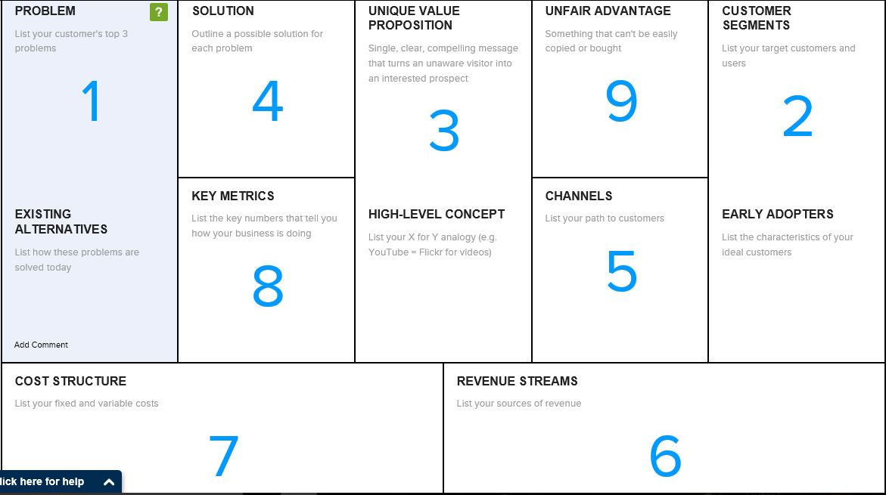

Slide 4
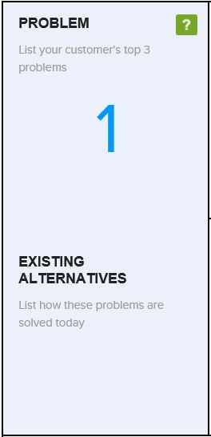
1. Problem and Existing Alternatives
1. List top 3 problems for the customer segment you are working with
What do they need solved?
2. List Existing Alternatives
How is the customer segment currently trying to solve their problems?

Slide 5
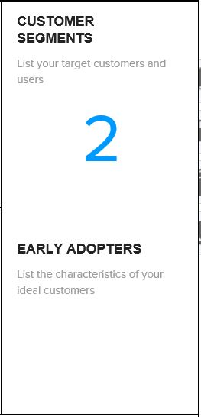
2. Customer Segments
1. List your target customers and users
Who is your startup for?
How will users and customers interact?
2. List early adopters
Get more specific on the customer segment – narrow down distinguishing characteristics of a prototypical customer
Define an early adopter – not a mainstream consumer

Slide 6
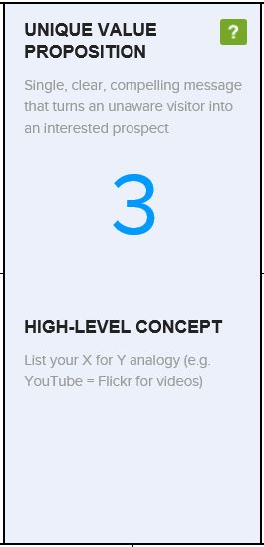
3. Unique Value Proposition
Answer What, Who, and Why?
What is your product?
Who is your customer?
Why?
Example UVP: CloudFire – Photo and Video Sharing for Busy Parents
“Get back to the more important things in your life.”
Then Create a High-Concept Pitch
A high-concept pitch builds on other familiar concepts to quickly get an idea across
Example: YouTube: “Flickr for Videos”

Slide 7
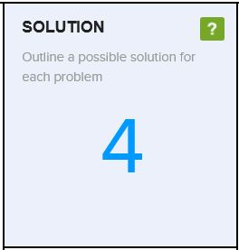
4. Solution
List a possible solution for each problem
At the beginning of the Lean Startup process, these will be untested hypotheses
Bind a solution to each problem as late as possible

Slide 8
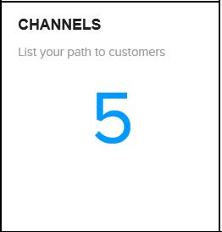
5. Channels
List your path to customers
It is critical to start finding, building, and testing a significant path to your customers from day one
Pay attention to which channels are inapplicable to your startup and which channels may be more viable in later stages of your startup

Slide 9
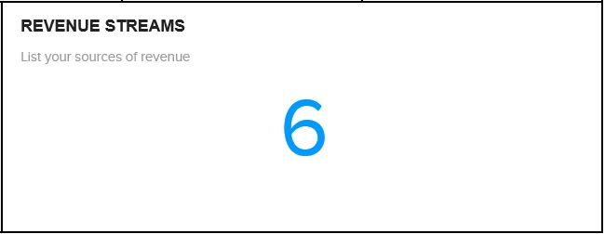
6. Revenue Streams
List sources of revenue
When pricing your solution, consider:
Starting with a single pricing plan – return on learning is diluted when you attempt to target multiple customer segments at once
Use a “Free Trial” plan – time-based trials help force a conversion decision which allows you to learn and iterate faster
Pick a Price Test - Existing alternatives create “reference points” in the minds of customers
Take your costs into account

Slide 10
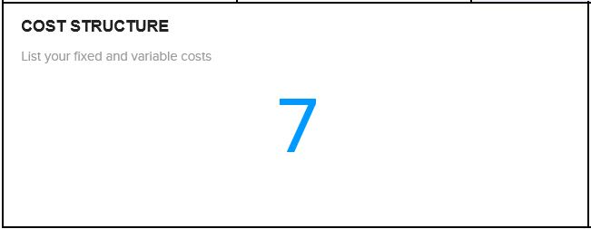
7. Cost Structure
List fixed and variable costs
Less of an itemized list of costs
What costs will you incur through key operations?

Slide 11
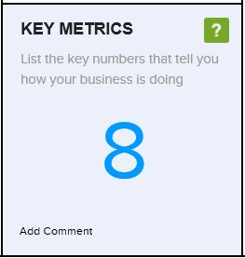
8. Key Metrics
List key numbers that tell you how your business is doing
This allows you to have feedback to possibly change your product mix or pricing strategy
Example: Amazon:
Sales conversion per visitor to the site – of every visitor, how many actually buy something?
Average Sales Transaction – of everyone that buys something, how much are they spending on average?

Slide 12
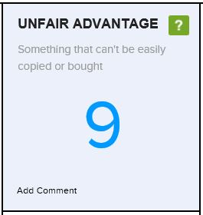
9. Unfair Advantage
What do you do differently that cannot be easily copied or bought by others?
Usually the hardest section to complete
May not have an unfair advantage in early startup stages
Example: Amazon has an unlimited selection of books and great customer service

Slide 13
After Completing the Lean Canvas
Your next objective is to find a big enough market that you can reach with customers who need your product that will pay a price that you can build a business around
Pick customer segments that need your product the most. The goal is to have one or more of your top three problem as “must-haves” for them.
Build a path to these customers. How easy is it to reach them?
Pick a customer segment that allows you to maximize on price.
Pick customers that represent a big enough market, or are a stepping stone to a big enough market, that you can build a business around.

Slide 14
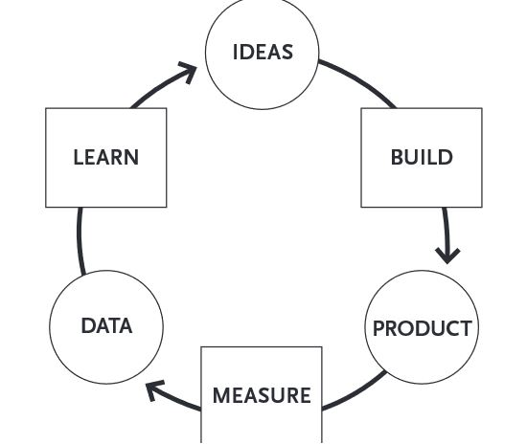
Test the hypotheses on your Lean Canvas
After reaching customers, what have you learned?
Which hypotheses need to be changed?
Continue to develop your Lean Canvas until your hypotheses are confirmed
Continue to Build – Measure –Learn
Learn as much as possible and decrease total time through the Build-Measure-Learn Feedback Loop (right)

Slide 15
Sources
Maurya, A. (2012, February 27). LeanStack. Retrieved from LeanStack: https://leanstack.com/why-lean-canvas/
Maurya, A. (2012). Running Lean: Iterate from Plan A to a Plan that Works. Sebastopol: O'Reilly Media, Inc.
Maurya, A. (2014, March 3). LeanStack. Retrieved from LeanStack: http://leanstack.com/LeanCanvas.pdf
Ries, E. (2011). The Lean Startup: How Today's Entrepreneurs. New York: Crown Business.

