Slide 1
Historicism Project
By Anna Busi

Slide 2
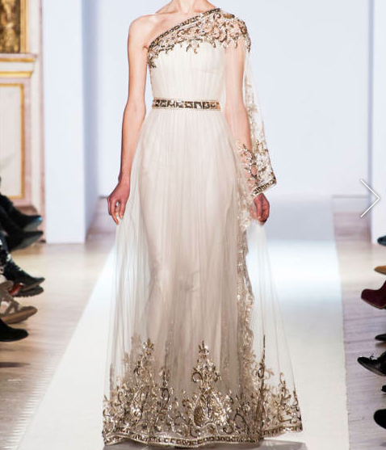
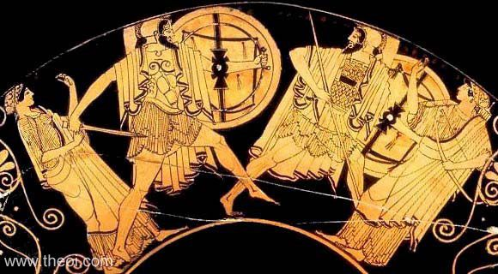
K10.9 THE TROJAN WAR - DUEL OF PARIS & MENELAOS
Museum Collection: Musée du Louvre, Paris, France Catalogue Number: Louvre G115 Beazley Archive Number: 205119 Painter: Signed by Douris Date: ca 485 - 480 BC http://www.theoi.com/Gallery/K10.9.html
485 – 480 BC
The Zuhair Murad gown on the left is a modern Grecian inspired dress. In Greek mythology, as seen in the pottery image of Artemis and Aphrodite (outer two figures), typical Grecian garments had fabric draped over the body and was synched around the waist to hold it up and the extra fabric was thrown over one shoulder. These classic Grecian elements can be seen in Murad’s gown on the right with the draped/roused bodice, the belted waist, and the one shoulder element. In Greek mythology, this type of dress was normal and was worn on a day to day basis where as this Murad gown is intended for a more formal and elegant use.
Zuhair Murad Spring Haute Couture 2013
http://www.elle.com/runway/haute-couture/spring-2013-couture/zuhair-murad/collection/#slide-37

Slide 3
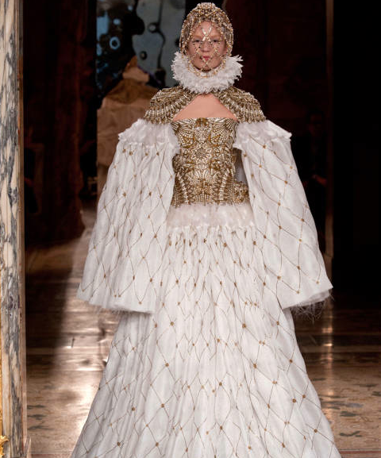
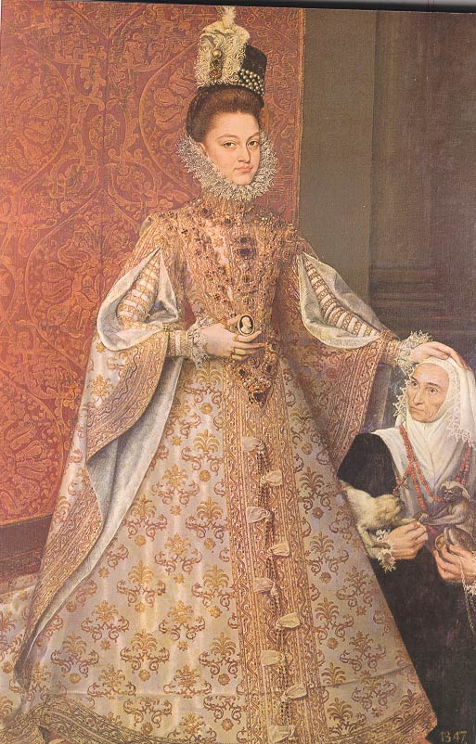
1584
This Alexander McQueen gown on the left has pulled inspiration from the 16th century, which can be seen in the painting on the left. The similarities lie in the large collar around the neck, the volume in the sleeves, and the fuller skirt. The 16th century was a time of formality and extravagance with royalty. Those elements are used to make the McQueen gown over-the-top and awe-inspiring. Though the McQueen gown is not practical for everyday fashion, it is opulent and extravagant and strongly exudes a 16th century regality. It is intentionally impractical for everyday wear and would make a great gown for a couture event.
Alexander McQueen Fall RTW 2013
http://www.elle.com/runway/ready-to-wear/fall-2013-rtw/alexander-mcqueen/collection/#slide-7
Artist: Follower of Coello Alonso
Title: The Infanta Isabel Clara Eugenia with Magdalena Ruiz,1584
Museum: Museo del Prado, Madrid, Spain

Slide 4
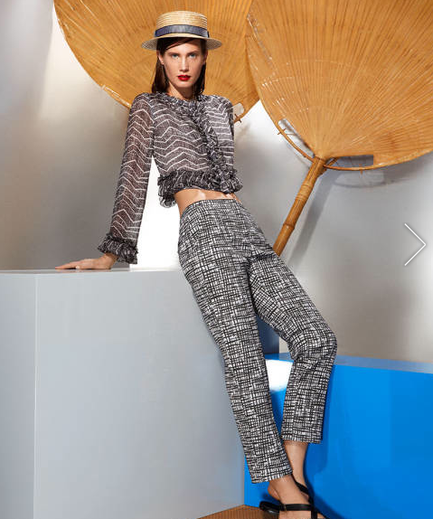
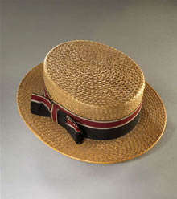
1890-1910
The straw boater hat of the early 1900s was historically worn as a men’s accessory for daytime occasions, typically when the men would go boating and have tea with their significant others and friends. However, we are seeing Missoni using these straw boater hats in their Resort 2014 line for women. The modern boater hats still maintain this casual feel despite the switch in the gender of the intended wearer. This hat is very summery and would make for a great hat to wear on a hot day. The only visual difference between the historical boater and the modern day rendition would be more modern ribbons and a slightly more rounded top
Number: BATMC II.12.57
Material(s): straw and silk
Creation date: 1890-1910
http://www.fashionmuseum.co.uk/collections/collection_search/DressDetails.aspx?objectID=batmc_ii_12_57
Missoni Resort 2014
http://www.elle.com/runway/resort/resort-2014/missoni/collection/#slide-15

Slide 5
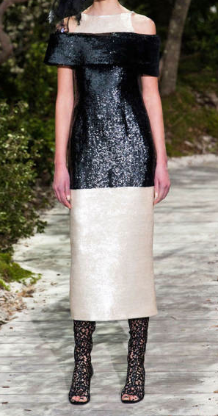
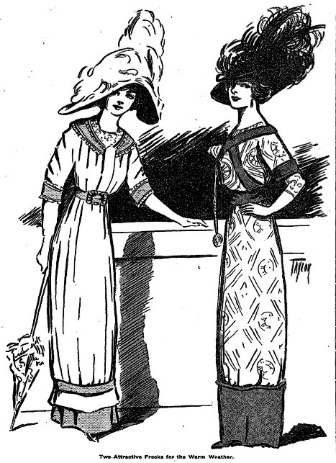
1900-1910
This Chanel dress on the left is very reminiscent of the hobble skirt of the early 1900’s. A typical hobble skirt would have a band along the bottom of the dress, which would restrict movement of the legs from about the knees up. This is very similar to the Chanel dress to the left. Though it is a little shorter than the floor length dresses that may have been seen in the early 1900’s, the garment was created without a slit and a very narrow skirt which would make it very difficult for the garment wearer to walk. The hobble skirt was intended to be worn in the summer time as a daytime dress, despite that inability to move. However this was not as big of an issue then due to the fact that women were more proper and would not have been as active or sporty as women today would be. Therefore, the modern Chanel version of the hobble skirt is slightly impractical, but would be used for an elegant evening where quick movement wouldn’t be necessary.
Chanel Spring Haute Couture 2013
http://www.elle.com/runway/haute-couture/spring-2013-couture/chanel/collection/#slide-48
New York Times
Published May 22, 1910
http://query.nytimes.com/mem/archive-free/pdf?res=9D07E1D71139E333A25
751C2A9639C946196D6CF

Slide 6
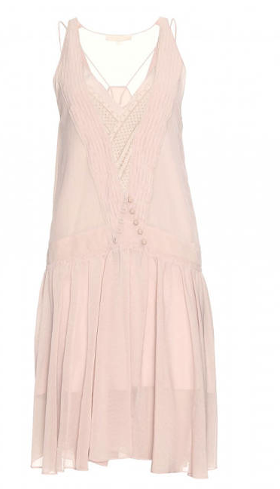
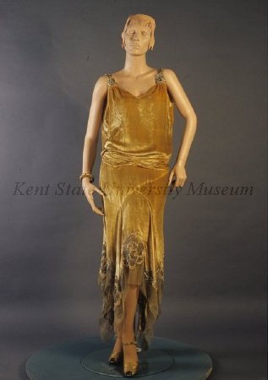
1927-1929
The Vanessa Bruno Chiffon dress on the left is a great example of a 1920’s inspired gown for many reasons. In particular, the dropped waist gives a more boyish silhouette which was very common in the 20’s. Additionally, the slightly shorter hemlines were very popular. The 20’s is the first time in history where women weren’t being held to as high of a standard and were not as proper as in the 19th century, so this shorter hem was a new, liberating development in fashion in the 1920’s. The modern interpretation of this dress is very unlike the silhouettes and lengths of current day dresses. Modern women want to accentuate their feminine curves and wear shorter dresses, therefore, this 1920’s inspired dress is noticeably retro, but is a refreshing change to the current fashions.
Vanessa Bruno Chiffon Dress
http://www.elle.com/fashion/trend-reports/great-gatsby-style#slide-12
Object Number: 1983.001.0358 ab
Date: 1927-1929
Kent State Fashion Museum

Slide 7
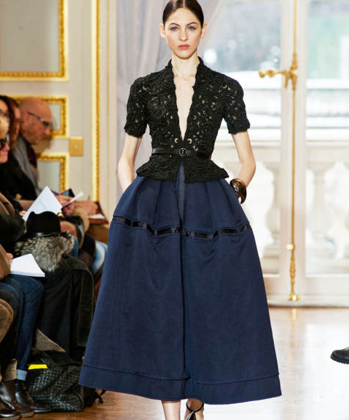
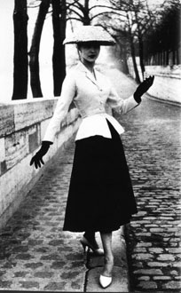
1947
The Christophe Josse ensemble is using inspiration from a Christian Dior gown from the New Look collection in 1947. Josse’s garment ties in elements relating back to the 1940’s look such as the tightly synched waist, the peplum, and the A-line skirt. The New Look was created for women to embrace their shapes and exude femininity. Women were gaining more and more independence as the decades progresses and the New Look definitely wanted to express this growing confidence, especially after WWII and the L-85 regulations that were placed. Christophe Josse’s ensemble uses these ideas from the 1947 garment and created a look that is both feminine but slightly powerful at the same time. It is very in line with the mentality of the modern woman – wanting to feel beautiful but capable at the same time.
CHRISTIAN DIOR
Bar suit, the New Look collection, 1947
ADAGP Archives, Paris 1996
Archives Christian Dior
http://designmuseum.org/design/christian-dior
Christophe Josse Spring 2013 Haute Couture
http://www.elle.com/runway/haute-couture/spring-2013-couture/christophe-josse/collection/#slide-8

Slide 8
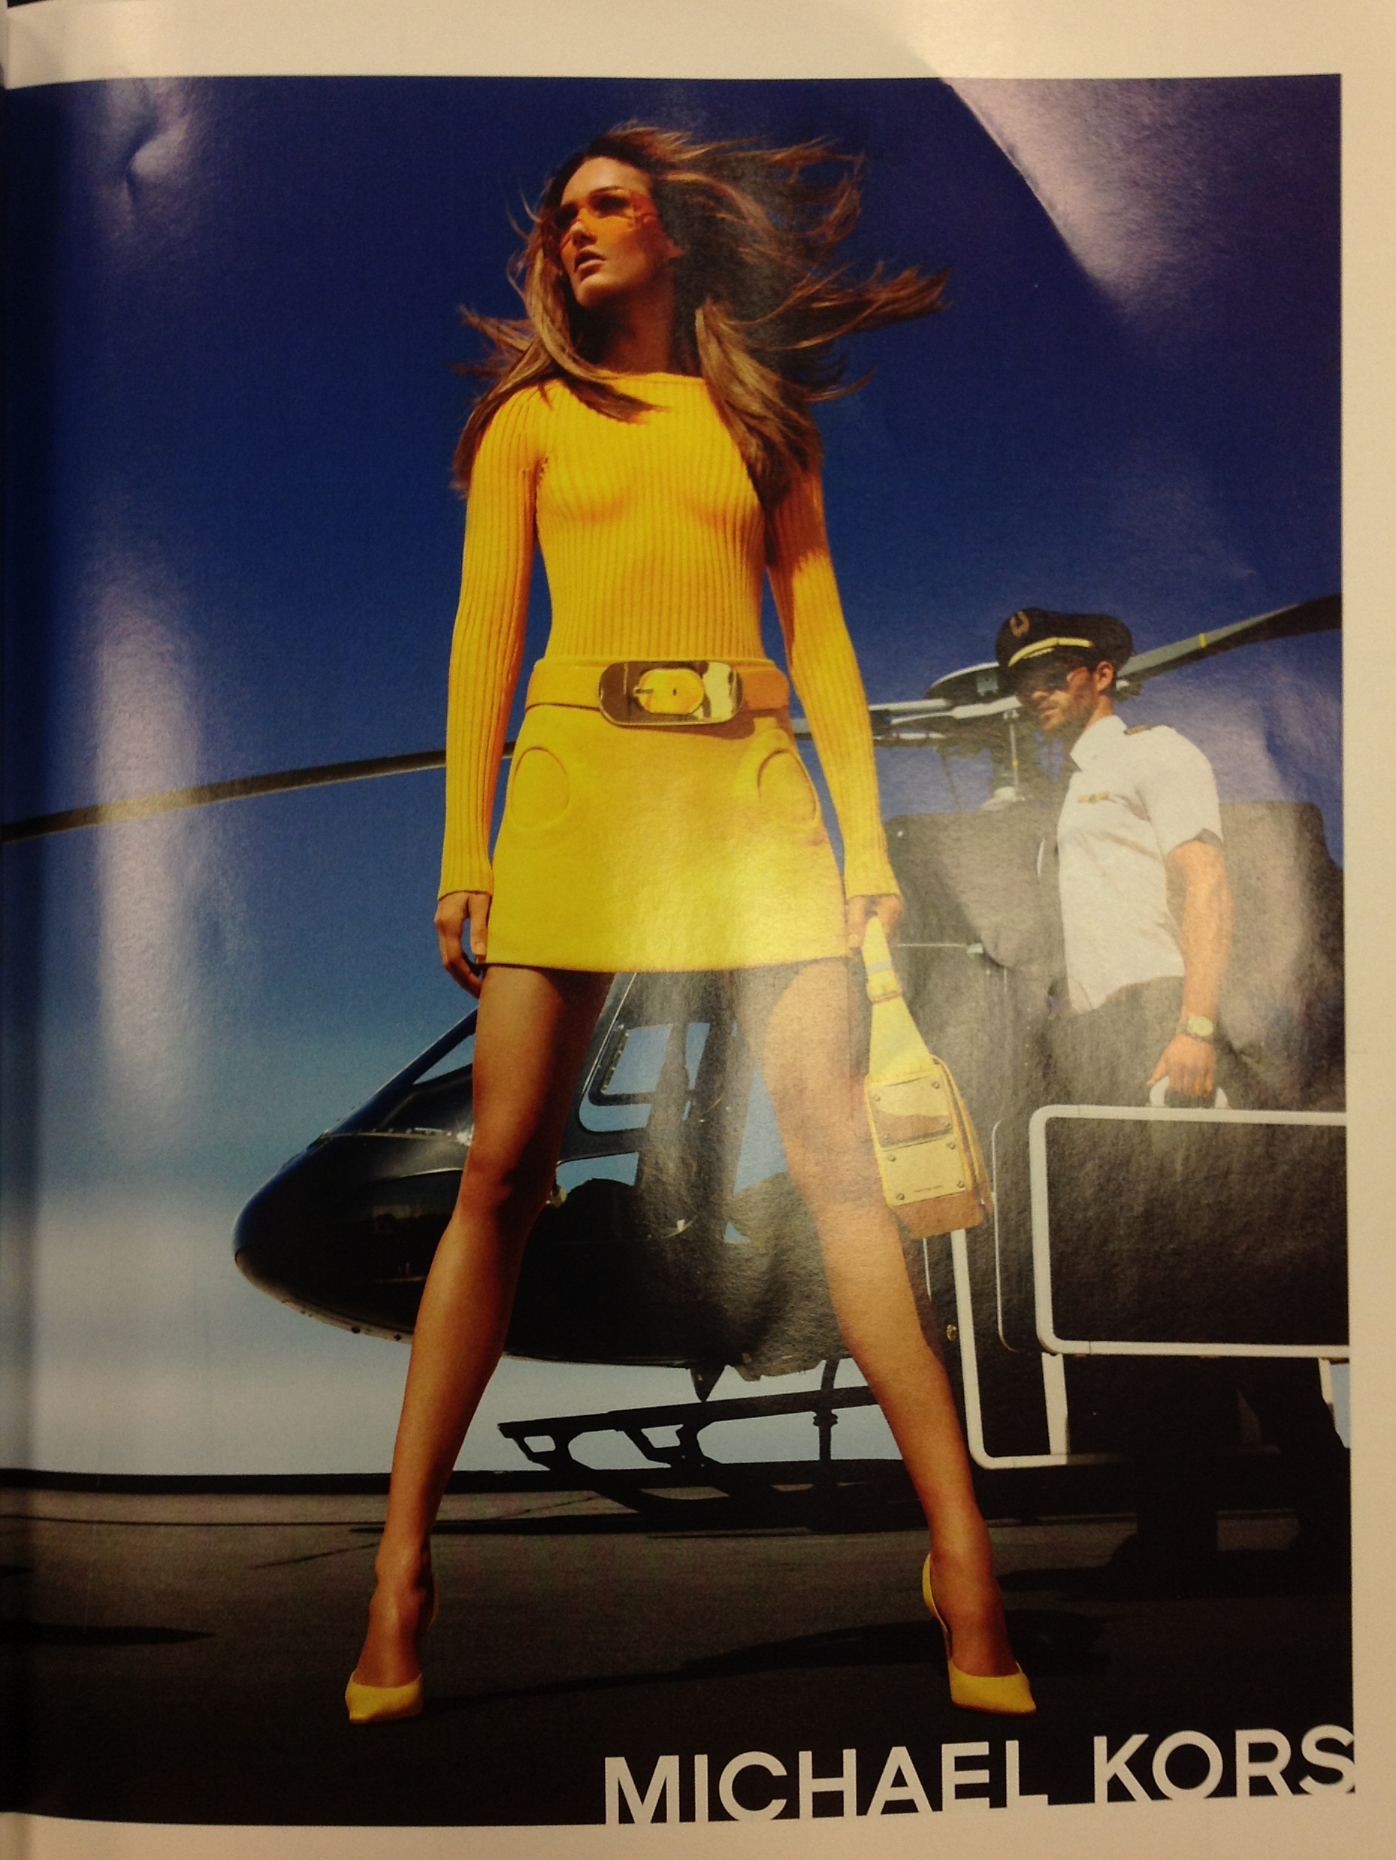
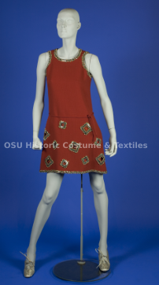
1960
The Michael Kors mini skirt, as seen on the right, was firs inspired by the mini of the 1960’s. The Pierre Cardin 60’s garment, though not technically two pieces, is very similar to the Kors skirt. The hemline in both garments are very short and both have an A-line cut and stops just over the hips. The round, geometric circles acting as pockets on the Michael Kors rendition are also indicative of the 1960’s mod fashion. The mini, in both the 60’s and in modern day fashion is made to be worn casually but to still be feminine and sexy, especially with the amount of leg that is shown.
Vogue Met Gala 2013 special edition pg. 9
Source: HCT.1985.22.3
Decade: 1960-1969
Designer: Cardin, Pierre
OSU Historic Costume Collection

Slide 9
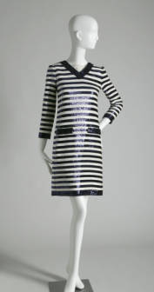
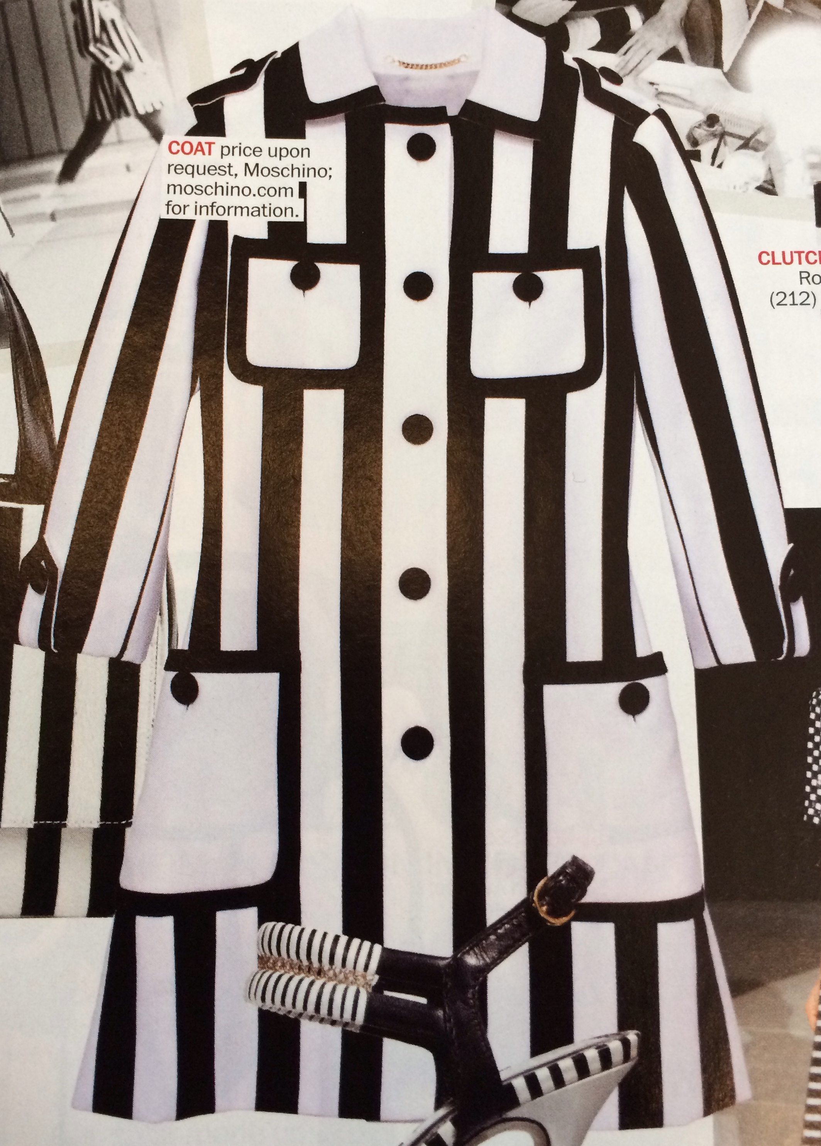
1966
The dress found in Marie Claire on the left is pulling elements from the 1960’s, particularly from op art inspiration. It’s black and white geometric pattern and loose silhouette that hangs away from the body is very indicative of the 1960’s. The Yves Saint Laurent look on the right uses a lot of the same elements, such as the op art geometric shapes and the shift style silhouette. The 60’s is when the hemline for dresses started to rise which made these looks casual and more feminine. The modern version of this 60’s look still plays on the same casual feel but the geometric pattern makes it feel retro and different.
Marie Claire January 2013 pg. 27
Dress, 1966. Sequins. Yves Saint Laurent, France. Gift of Miss Genevieve W. Urbain. 1982.168.3 – Chicago History Museum
http://digitalcollection.chicagohistory.org/cdm/compoundobject/collection/p16029coll3/id/1466/rec/125

Slide 10
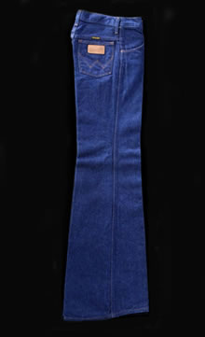
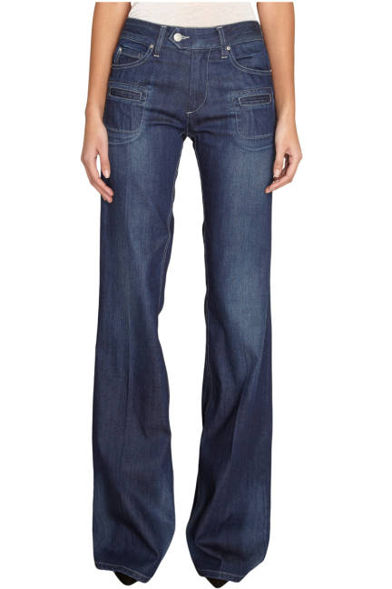
1974-1978
Jeans in the current fashion industry always are changing their shape. These particular jeans to the right, which Elle magazine noted as one of the go-to style for denim for Fall 2013, are referencing the bell bottom jeans of the 1970’s. The Elle magazine jeans are moderately high-waisted and have the large, wide flare at the bottom - much like the jeans from the Fashion Museum, Bath, UK from the 1970’s. These jeans were typical in the 70’s for casual everyday wear and are resurfacing in modern fashion with ultimately the same purpose.
Elle Magazine online
Fall Denim Guide 2013
http://www.elle.com/fashion/trend-reports/fall-2013-denim#slide-66
Number: BATMC 94.526
Creation date: 1974-1978
Fashion Museum, Bath, UK
http://www.fashionmuseum.co.uk/collections/collection_search/DressDetails.aspx?objectID=batmc_94_526

Slide 11
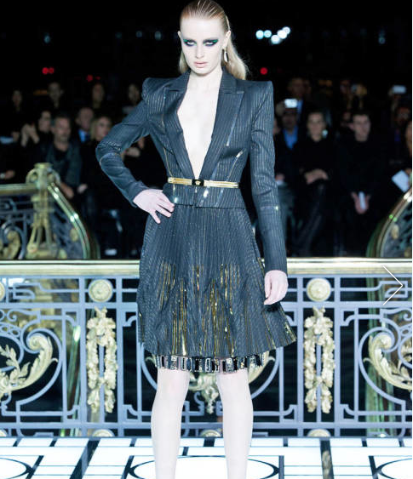
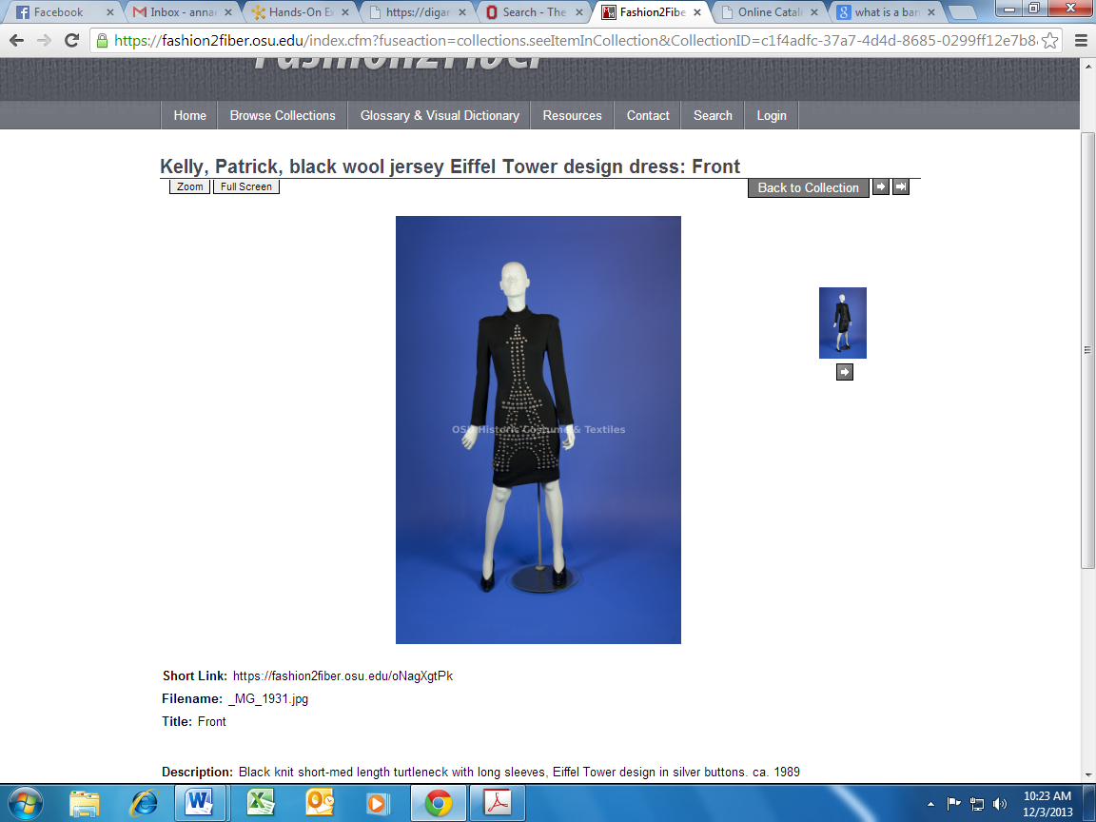
1980-1989
The Versace suit on the left is using elements of fashion from the 1980’s. This is apparent with the broad shoulders, made bigger with shoulder pads, and then tapering into a more narrow waist. The Patrick Kelly Paris dress on the right also sports these different 80’s elements with the shoulder pads and a hourglass shape which accentuates the narrower waist. The 1980’s occurred just after the Cold War ended and when women were starting to enter the workforce full time. This broadness on top made women feel more powerful. This applies to modern day fashion because women are very independent and sometimes like to sport a stronger, more sophisticated look.
Versace Spring 2013 Haute Couture
http://www.elle.com/runway/haute-couture/spring-2013-couture/versace/collection/#slide-4
Source: HCT.1990.564.1
Decade: 1980-1989
Designer: Patrick Kelly Paris
OSU Historical Costume Collection

