Slide 1
Anthropology is…….
The field of inquiry that studies HUMANS THROUGHOUT TIME AND ALL OVER THE WORLD, IT FOCUSES ON BIOLOGICAL AND CULTURAL CHARACTERISTICS, VARIATION AND EVOLUTION.

Slide 2
4 MAIN SUBFIELDS

Slide 3
Cultural Anthropology
It is the study of the learned patterns of beliefs and behaviors found in both modern and historic cultures.
It BEGAN IN THE 1800S AS EUROPEANS BEGAN TO EXPLORE NON-EUROPEAN CULTURES.
ethnography – a tool used by cultural anthropologists which is a descriptive account of a culture, usually by observation.
  The apotheosis of captain cook (1779) obeyesekere (outsider) vs sahlins (islander)
  The Yanomamo

Slide 4


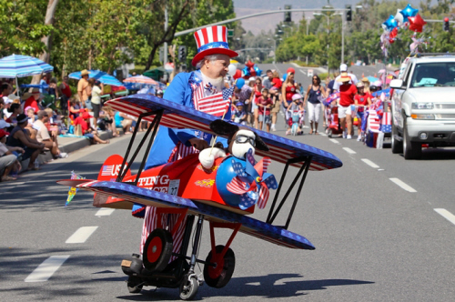
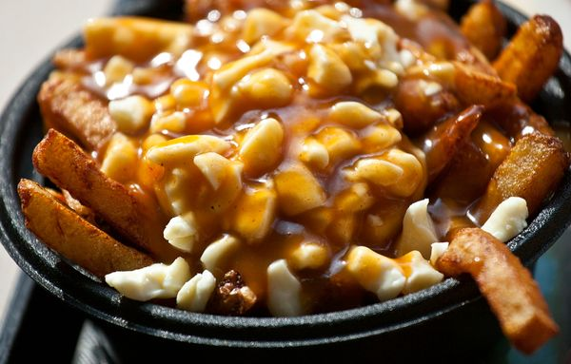
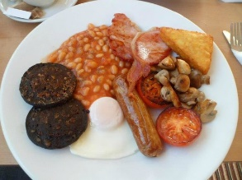
So what is human culture?
Human culture – is a Set of learned behaviors transmitted from one generation to the next through NON-GENETIC means
It is:
  Shared
  Patterned
  Integrated
  Learned
  Symbolic

Slide 5
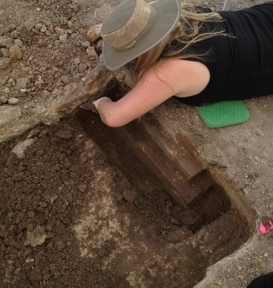
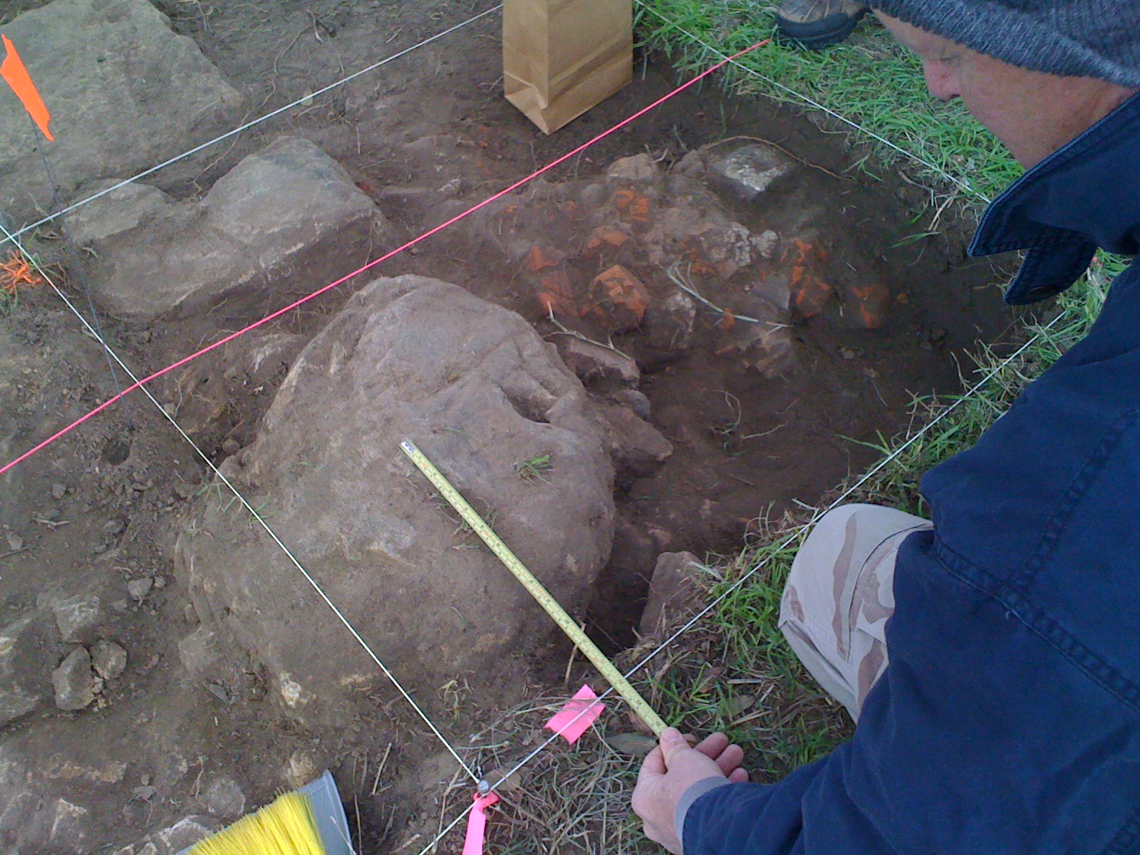
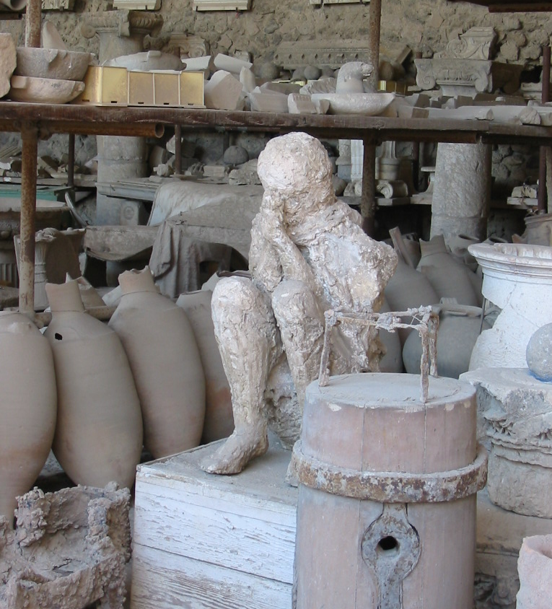
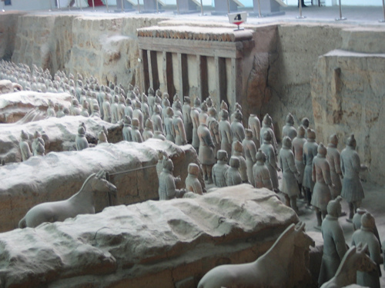
Archaeology
analysis and interpretation of earlier cultures by examining structures and artifacts left behind.

Slide 6
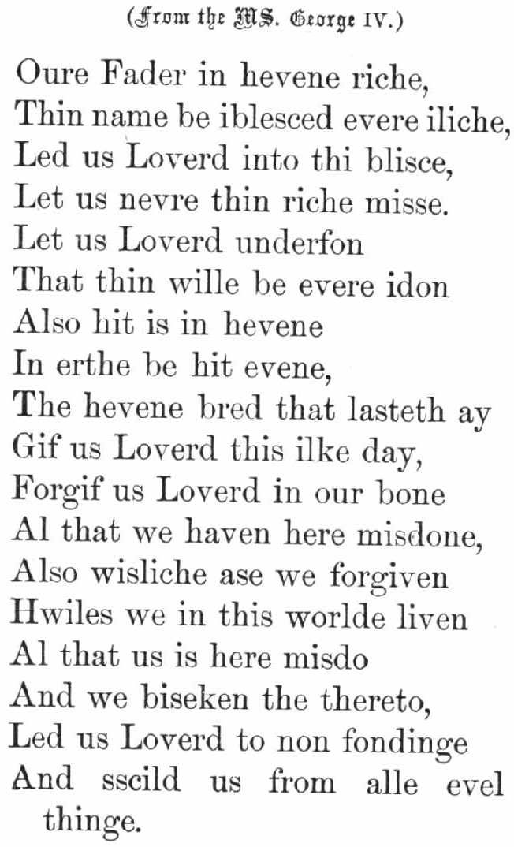
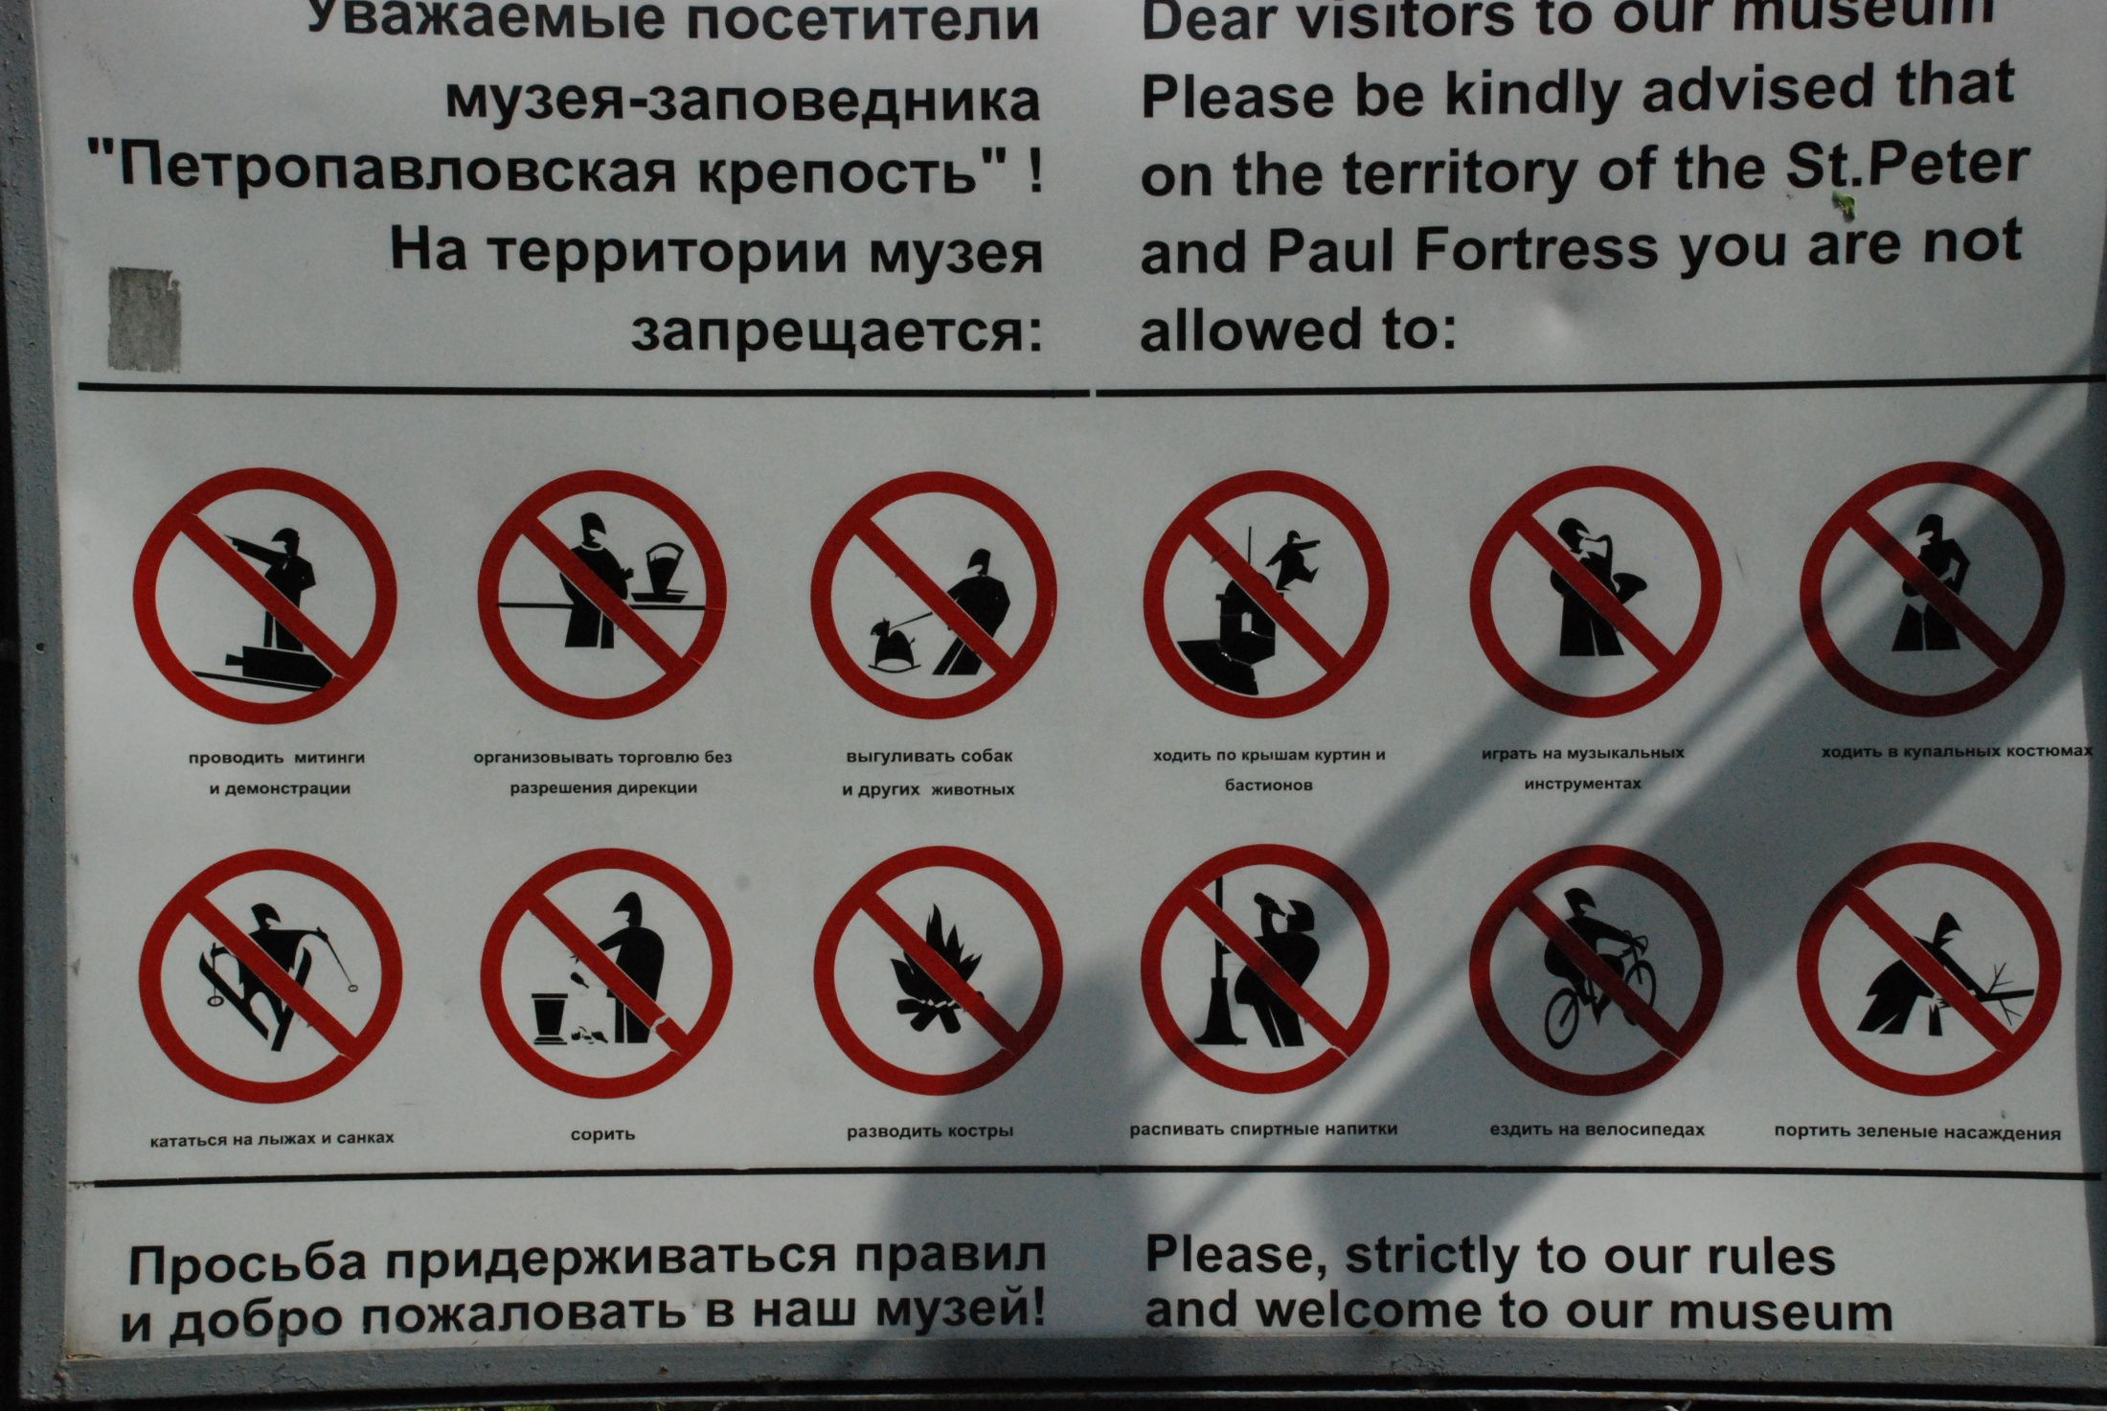
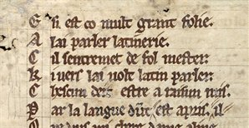
Linguistic Anthropology
The study of human speech and language
Example: historical linguistics applied to English
  5th century Middle English
  1066 Norman (from current France) English
  American, Canadian, s American, Indian ENGLISH
Semiotics – study of symbols

Slide 7
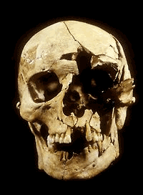
Physical or biological Anthropology
IT IS THE study of human biology framed by evolution and influenced by culture.
began when naturalists started to question the origin of our species and to question the literal interpretation of the bible
Today there are 5 main subfields – we will cover each of these fields in greater detail during this semester.
  Paleoanthropology
  Osteology or bioarchaeology
  Paleopathology
  Forensics
  primatology

Slide 8

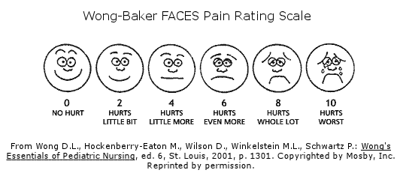
The nature of science
The scientific method - a PROCESS of being able to explain phenomena in a consistent way.
Hypothesis – an answer posed to a question about an observation
A scientific hypothesis must have a way to evaluate it by rational or empirical means. IF IT DOES NOT, This does not mean the statement is untrue, it simply means that it is not subject to the scientific method.
empirical - relying on experiment or observation, received through the senses
Variable – factors or properties that characterize an observation
Experiment – a test that compares 2 situations where 1 variable differs
two main types of data
Quantitative can be measured and expressed in terms of counts or quantity LIKE DATE OF BIRTH
Qualitative data measured by adjectives or descriptive terms LIKE MENTAL STATE (SAD, HAPPY)

Slide 9
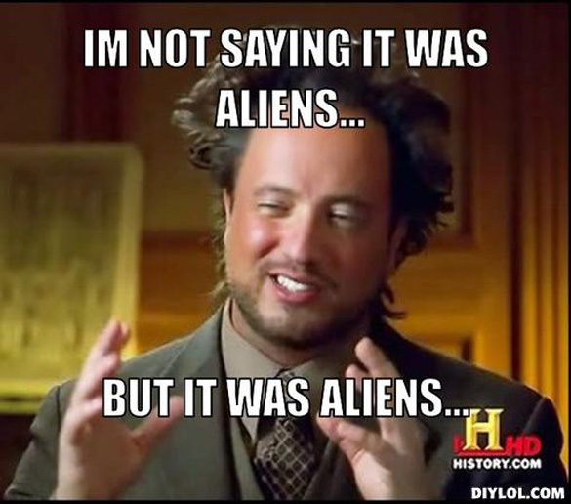
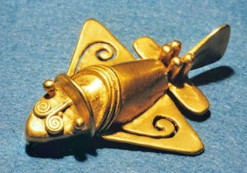
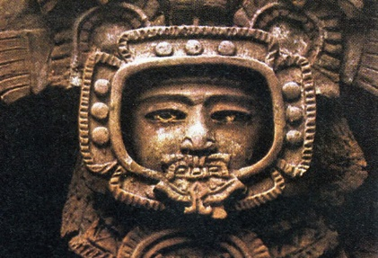
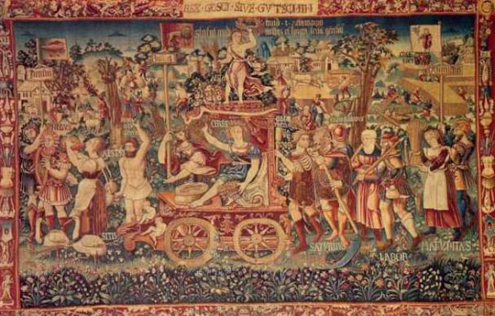
The nature of science
Theory – a hypothesis that has stood up to repeated testing and highly confirmed hypotheses, it is also a generalization about conditions not yet tested.
EXAMPLES:
  The Big Bang Theory
  GRAVITY (2 PARTS; THE LAW OF ATTRACTION AND THE THEORY OF WHY)
Pseudo theories
  LOCH NESS MONSTER AND BIG FOOT
  Ancient astronaut hypothesis
Is Evolution a theory?

Slide 10
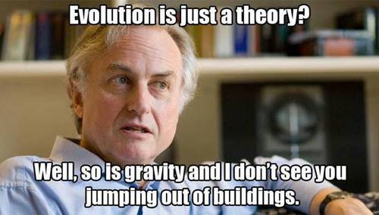
The nature of science
Evolution is a theory, IT is supported by so many observations and confirming experiments that scientists are confident that the basic components will not be overturned by new evidence.
LAWS DESCRIBE AND PREDICT WHAT NATURE DOES GIVEN CERTAIN CONDITIONS AND ARE OFTEN MATHEMATICALLY DEFINED, THEORIES EXPLAIN HOW NATURE WORKS AND ARE NOT SIMPLY “LAWS IN WAITING”
Science and theology
Both try to obtain answers to observable phenomena and predict non observable phenomena
Faith is taken as absolute truth a scientific statement is never considered to be irrefutably correct as new evidence can always be introduced
Some questions that are addressed by theology are not addressed by science as they cannot be subjected to empirical research

Slide 11
The Development of
Evolutionary Theory

Slide 12
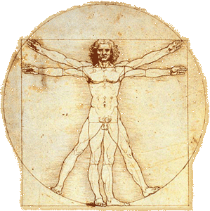
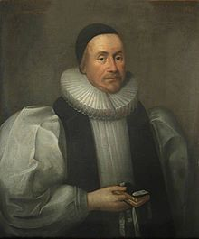
Questioning the old ideas
Common beliefs up until around the 16th century
Anthropocentricity - Humans are the most important elements in the universe and so is the earth, everything revolves around us
  Ethnocentric – your culture is the best
  Eurocentric – Europeans belief that European culture is the best
Life was spontaneously generated from non living material
Once created life forms were immutable (unchanging) also called the fixity of species theory
The earth was 6000 years old – created October 23, 4004 bc according to the biblical timeline set forth by reverend James ussher (1580 -1655)

Slide 13
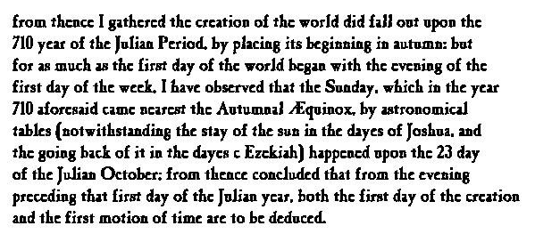
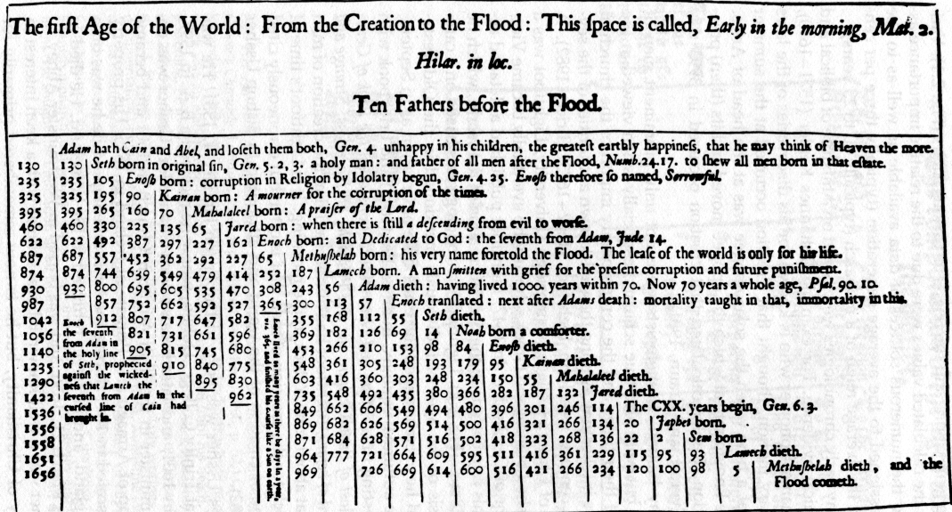

Slide 14
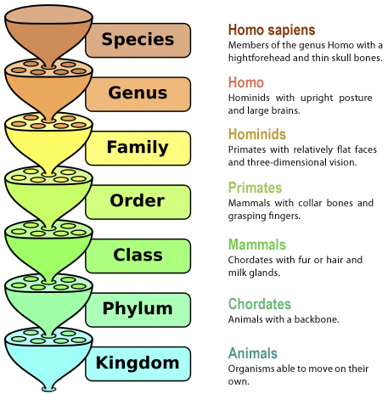
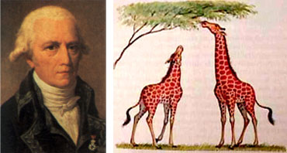
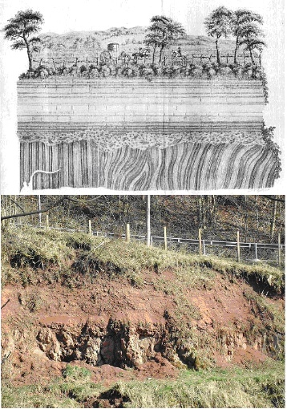
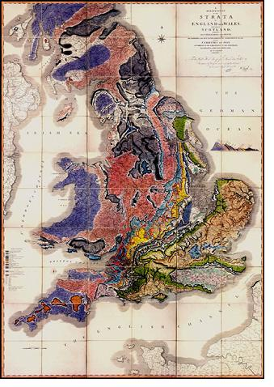
IS NATURE DYNAMIC NOT FIXED?
Renaissance (Starts 15th century)
  circumnavigation ended the belief that the world was flat
  Galileo argued for the earth revolving around the sun
Carolus Linnaeus (16th century)
  Classification and the basis of taxonomy – first to classify humans as animals – questioned fixity
Jean-Baptiste Lamarck (18th century)
  NATURE PROMOTES CHANGE OF BODY PARTS
  PRINCIPLE OF USE AND DISUSE “VITAL FORCES” THEORY – ENVIRONMENT LEADS TO INCREASED, DECREASED OR ELIMINATION OF BODY PARTS LIKE THE GIRAFFE’S NECK
  PRINCIPLE OF ACQUIRED CHARACTERISTICS – CHARACTERISTICS ACQUIRED DURING A LIFETIME CAN BE PASSED TO OFFSPRING
Georges Cuvier (17th Century)
  Catastrophism – earth is formed by worldwide cataclysmic events THAT DESTROY LIFE AND CREATION EVENTS
Charles Lyell (18th century) – Geologist
  Uniformitarianism – geological processes are consistent and ongoing, so the earth is far older than biblical timeline
  STRATA – LAYERS OF SEDIMENTARY ROCKS TERM NAMED AFTER WILLIAM “STRATA” SMITH – CREATED GEOLOGY MAP OF ENGLAND

Slide 15
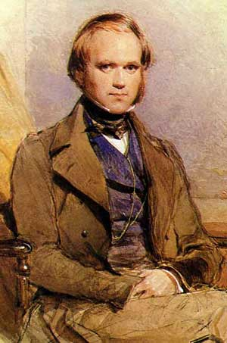
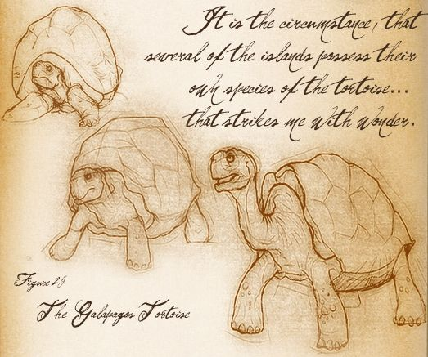
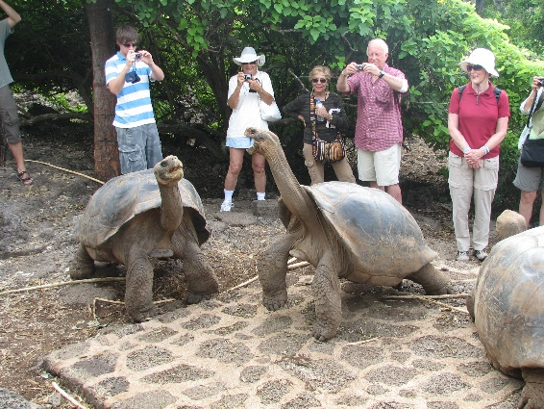
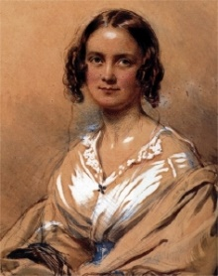
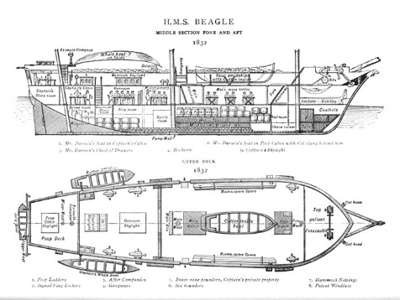
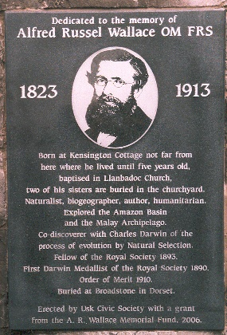
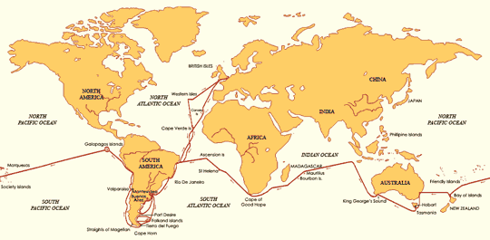
Charles Darwin (1809 – 1882)
  Influenced by his grandfather Erasmus who was part of the leading intellectual community
  Other Grandfather was wealthy Josiah Wedgewood famous for Wedgewood China
  Father was a physician and he was one of six children, mother died when he was eight years old
  Studied medicine at Edinburgh University (Scotland) but hated it and left after two years
  Studied theology at Cambridge and graduated in 1831
  Lived in a world of change where the reform movement was trying to undo class inequalities and any “new ideas” were seen as subversive and likely to undo the moral teachings of the church
  Married his cousin Emma Wedgwood
The voyage of the Beagle – five years starting in 1831
  Galapagos Islands - realized that even though the animals were similar to mainland animals they had some physical traits that were very different
  Hypothesized that the Galapagos finches had all descended from a common ancestor and had been modified over time to respond to the different island environments
On the origin of the species
  When Darwin returned home, he started to study animal breeders who selected against certain traits by breeding animals with desirable traits to other animals with desirable traits
  In 1858, another scholar Alfred Russell Wallace sent a paper to Darwin “On the tendency of Varieties to Depart Indefinitely from the Original Type”
  Worried that he wouldn’t get credit for his ideas that were similar to Wallace’s, he rushed to publish “On the origin of the species”

Slide 16
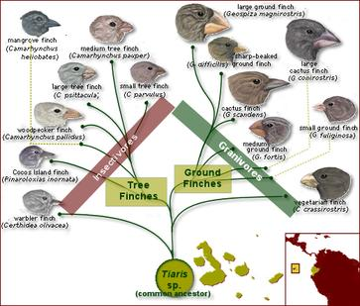
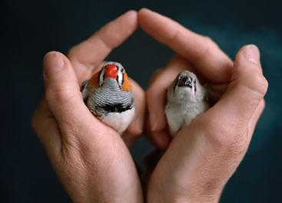
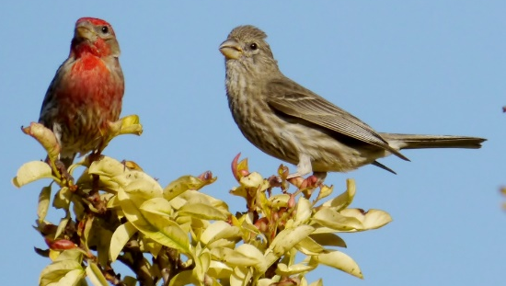
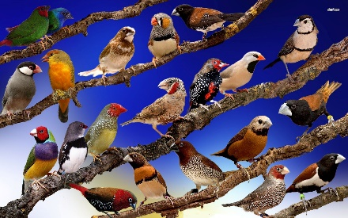
Natural Selection the key to evolution
NATURAL SELECTION – DIFFERENTIAL FERTILITY AND MORTALITY OF VARIANTS WITHIN A POPULATION
Darwin recognized that there is a struggle for survival and that population size will be limited by access to food and water therefore those with favorable traits or variations that allowed them to compete favorably for food and water would be more likely to survive to adulthood and create offspring with these favorable traits. Favorable variations would be preserved in this way and unfavorable ones would die out and in this way species would evolve.
Eastern House finch - Texas

Slide 17
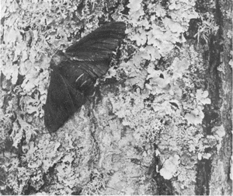

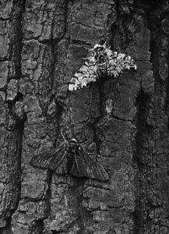
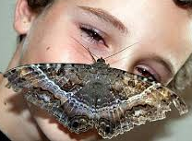
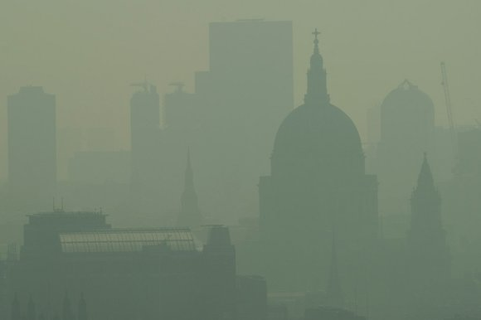
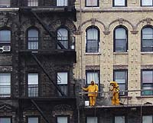
EXAMPLE OF NATURAL SELECTION
INDUSTRIAL MELANISM - THE FREQUENCY OF A DARK VARIANT OF A SPECIES INCREASES IN RELATION TO A LIGHTER VARIANT IN RESPONSE TO CHANGES IN THE ENVIRONMENT DUE TO POLLUTION CAUSED INCREASING INDUSTRIALIZATION
ENGLISH PEPPERED MOTH

Slide 18
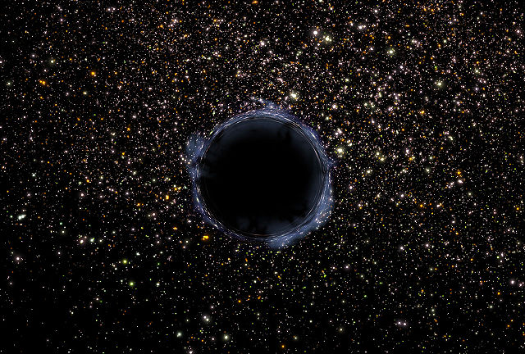
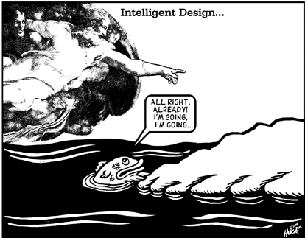
INTELLIGENT DESIGN
THE CONCEPT OF NATURAL SELECTION HAS STOOD UP TO 150 YEARS OF TESTING AND IS ONE OF THE MAIN FOUNDATIONS OF MODERN BIOLOGICAL SCIENCE
ANOTHER VIEW IS CREATION SCIENCE OR INTELLIGENT DESIGN – A RELIGIONS EXPLANATION OF THE WORLD THAT ASSUMES THE EXISTENCE OF A SUPERNATURAL FORCE
IRREDUCIBLE COMPLEXITY – THE IDEA THAT THERE EXIST PROCESSES AND STRUCTURES THAT ARE TOO COMPLEX TO HAVE ARISEN THROUGH EVOLUTIONARY MECHANISMS

